Slide 1
Predicting the Occurrence of Diabetes in the next year
Jan 2, 2020

Slide 2
Introduction
Diabetes Mellitus (DM) is a chronic, metabolic disease characterized by impaired ability of the body to produce or respond to insulin and thereby maintain proper levels of sugar (glucose) in the blood
Predicting the incidence of diabetes ahead of time will help to mitigate the complications and death from it
The objective of this study is to build a machine learning (ML)-based model to predict the occurrence of diabetes mellitus in the next year
Machine-learning models can be trained to find patterns in patient medical data to aid in the screening diagnosis and risk prediction of several diseases.
In this study, DM is classified into three groups based on the fasting plasma glucose level (FPG)
Status | Fasting plasma Glucose (FPG) | HbA1c
Normal | FPG < 100 mg/dl | HbA1c < 5.7%
Prediabetes | 100 mg/dl ≤ FPG < 126 mg/dl | 5.7% ≤ HbA1c < 6.5%
Diabetes | FPG ≥ 126 mg/dl | HbA1c ≥ 6.5%

Slide 3
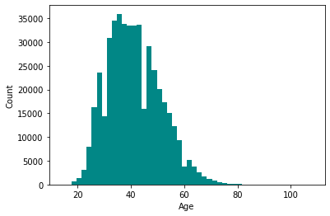
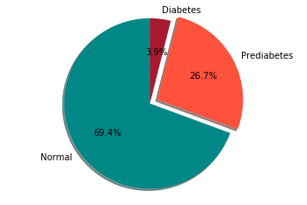
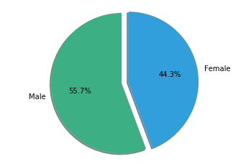
Dataset
Dataset was collected as Electronic health records (EHRs) from 2013 to 2018 at a medical agency located in Seoul, South Korea
The dataset has 535,169 instances from 253,395 patients and each instance has 1,444 features
Features consist of numerical values as well as categorical values
The numerical values are from blood biochemical analysis, anthropometric measurements, and other diagnostic results
The categorical values are from questionnaire answers.

Slide 4
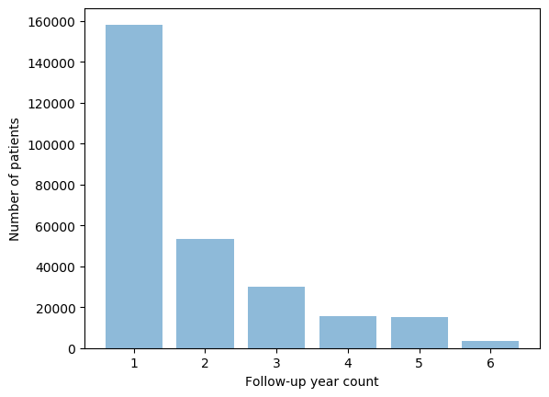
Dataset
This study considers only
Patients with at least 2 years of continuous annual medical check-up during the follow-up period
Patients who are not already diagnosed with Diabetes, hyperlipidemia, hypertension, and who are not on medication for those three abnormalities
Instances (or records) without null values on the required Features
The total number of instances after the preprocessing is 169,024
Unique number of patients is 80,692
Male patients count is 48,912
Female patients count is 31,780
The mean age is 41.17 ± 9.95
Region of interest

Slide 5
Prediction Models
The purpose of the prediction model is to forecast diabetes occurrence in the next year
The prediction model predicts the occurrence of diabetes as normal, prediabetes or diabetes
Four machine learning algorithms were utilized to generate the prediction model
Random forest (RF)
XGBoost
Support Vector Machine (SVM)
Stacking classifier (ensemble of RF, XGBoost and SVM)

Slide 6
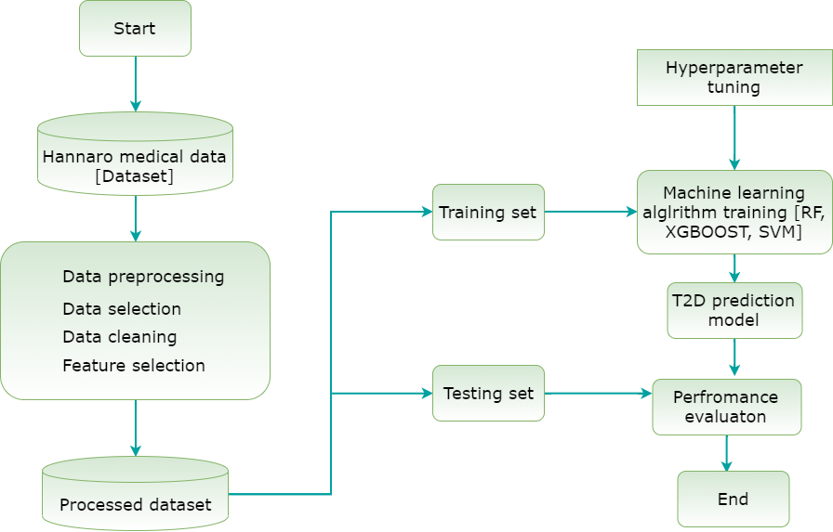
Prediction Models
The workflow of the prediction model including data preprocessing, training and testing phases are depicted in the figure below.

Slide 7
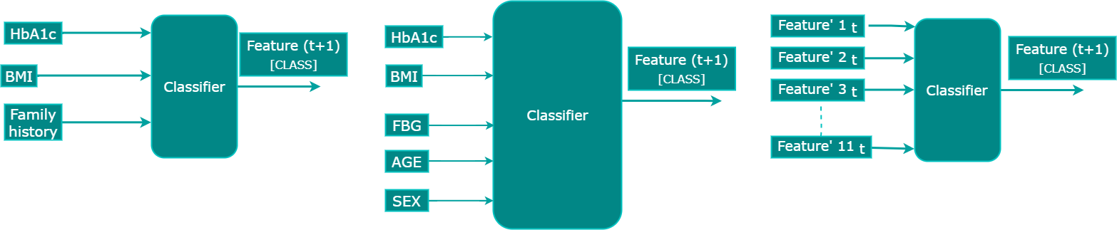
Methodology
Three feature sets are used to train the models
Traditional predictors: HbA1c, BMI, family history
5 - features set: Fasting blood glucose (FBG), HbA1c, BMI, age and sex
12 - features set: FBG, HbA1C, triglycerides, BMI, GTP gamma, sex, age, uric acid, smoking, drinking, physical activity and family history
The feature sets are the input for the prediction model and the output of the model is the next year diabetes occurrence, which is denoted as a class in the diagram below
(a)
(c)
(b)

Slide 8
Experiments
In this study, we conducted three experiments using the three feature sets
Traditional predictors
5 - features set
11 - features set
Since the dataset has a high-class imbalance, we used the Majority under-sampling technique and Synthetic Minority Over-sampling Technique (SMOTe) to adjust the class imbalance problem on the experiments.
Majority under-sampling: discard instances in the majority class so as to meet the percentage ratio used in the experiment. [training class ratio is 2:2:1 for normal, prediabetes and diabetes]
Synthetic Minority Over-sampling Technique (SMOTe) is a technique used to generate new points for minority class based on nearest neighbors judged by Euclidean Distance between data points in feature space.

Slide 9

Experiments
The performance of the prediction models is evaluated using
10 fold cross-validation on the training set and
Accuracy, Precision, Recall, and F1-score metrics on the test.
A$ccuracy=\frac{TP+TN}{TP+FP+FN+TN}$
P$recision= \frac{TP}{TP+FP}$
R$ecall= \frac{TP}{TP+FN}$
F1$−score= \frac{2∗\left( recall∗precision\right)}{recall+precision}$
Where TP= true positive, TN= true negative, FP= false positive, FN= false negative

Slide 10




Result – Classifier with traditional predictors
With majority under sampling technique
10 fold Cross Validation
Accuracy: 0.64 (+/- 0.01) [RF]
Accuracy: 0.65 (+/- 0.01) [XGBoost]
Accuracy: 0.65 (+/- 0.01) [SVM]
Accuracy: 0.64 (+/- 0.01) [StackingClassifier]
 | Accuracy | Precision | Recall | F1-score
RF | 0.665 | 0.66 | 0.67 | 0.66
XGBoost | 0.67 | 0.66 | 0.67 | 0.67
SVM | 0.666 | 0.67 | 0.67 | 0.67
Stacking Classifier | 0.663 | 0.66 | 0.66 | 0.66
 | Training | Testing
Normal | 956 | 200
Prediabetes | 1,912 | 200
diabetes | 1,912 | 200
Confusion matrix
RF
XGBoost
SVM
Stacking Classifier
0: Normal, 1= prediabetes, 2=diabetes

Slide 11




Result – Classifier with traditional predictors
(b) With SMOTe
10 fold Cross Validation
Accuracy: 0.70 (+/- 0.02) [RF]
Accuracy: 0.66 (+/- 0.01) [XGBoost]
Accuracy: 0.64 (+/- 0.01) [SVM]
Accuracy: 0.70 (+/- 0.01) [StackingClassifier]
 | Accuracy | Precision | Recall | F1-score
RF | 0.597 | 0.64 | 0.60 | 0.61
XGBoost | 0.678 | 0.68 | 0.68 | 0.68
SVM | 0.676 | 0.68 | 0.68 | 0.68
Stacking Classifier | 0.56 | 0.61 | 0.56 | 0.57
 | Training | Testing
Normal | 18,508 | 200
Prediabetes | 18,508 | 200
diabetes | 18,508 | 200
Confusion matrix
RF
XGBoost
SVM
Stacking Classifier
0: Normal, 1= prediabetes, 2=diabetes

Slide 12
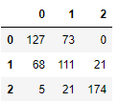
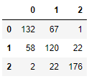
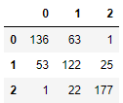
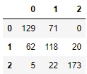
Result – Classifier with 5 features
With majority under sampling technique
10 fold Cross Validation
Accuracy: 0.77 (+/- 0.01) [RF]
Accuracy: 0.73 (+/- 0.01) [XGBoost]
Accuracy: 0.73 (+/- 0.02) [SVM]
Accuracy: 0.77 (+/- 0.01) [StackingClassifier]
 | Accuracy | Precision | Recall | F1-score
RF | 0.695 | 0.70 | 0.69 | 0.70
XGBoost | 0.713 | 0.72 | 0.71 | 0.71
SVM | 0.725 | 0.73 | 0.72 | 0.73
Stacking Classifier | 0.7 | 0.70 | 0.70 | 0.70
 | Training | Testing
Normal | 956 | 200
Prediabetes | 1,912 | 200
diabetes | 1,912 | 200
Confusion matrix
RF
XGBoost
SVM
Stacking Classifier
0: Normal, 1= prediabetes, 2=diabetes

Slide 13
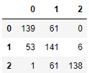
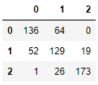
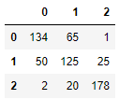
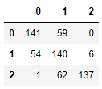
Result – Classifier with 5 features
(b) With SMOTe
10 fold Cross Validation
Accuracy: 0.75 (+/- 0.04) [RF]
Accuracy: 0.70 (+/- 0.04) [XGBoost]
Accuracy: 0.72 (+/- 0.03) [SVM]
Accuracy: 0.75 (+/- 0.04) [StackingClassifier]
 | Accuracy | Precision | Recall | F1-score
RF | 0.697 | 0.74 | 0.70 | 0.71
XGBoost | 0.725 | 0.73 | 0.72 | 0.73
SVM | 0.726 | 0.73 | 0.73 | 0.73
Stacking Classifier | 0.696 | 0.74 | 0.70 | 0.71
 | Training | Testing
Normal | 18508 | 200
Prediabetes | 18508 | 200
diabetes | 18508 | 200
Confusion matrix
RF
XGBoost
SVM
Stacking Classifier
0: Normal, 1= prediabetes, 2=diabetes

Slide 14




Result – Classifier with 12 features
With majority under sampling technique
10 fold Cross Validation
Accuracy: 0.73 (+/- 0.01) [RF]
Accuracy: 0.73 (+/- 0.01) [XGBoost]
Accuracy: 0.73 (+/- 0.02) [SVM]
Accuracy: 0.73 (+/- 0.01) [StackingClassifier]
 | Accuracy | Precision | Recall | F1-score
RF | 0.742 | 0.75 | 0.74 | 0.75
XGBoost | 0.743 | 0.75 | 0.74 | 0.75
SVM | 0.746 | 0.75 | 0.75 | 0.75
Stacking Classifier | 0.741 | 0.75 | 0.74 | 0.75
 | Training | Testing
Normal | 842 | 200
Prediabetes | 1,684 | 200
diabetes | 1,684 | 200
Confusion matrix
RF
XGBoost
SVM
Stacking Classifier
0: Normal, 1= prediabetes, 2=diabetes

Slide 15




Result – Classifier with 12 features
(b) With SMOTe
10 fold Cross Validation
Accuracy: 0.77 (+/- 0.04) [RF]
Accuracy: 0.72 (+/- 0.04) [XGBoost]
Accuracy: 0.72 (+/- 0.03) [SVM]
Accuracy: 0.77 (+/- 0.04) [StackingClassifier]
 | Accuracy | Precision | Recall | F1-score
RF | 0.695 | 0.74 | 0.69 | 0.70
XGBoost | 0.745 | 0.76 | 0.74 | 0.75
SVM | 0.743 | 0.76 | 0.75 | 0.75
Stacking Classifier | 0.691 | 0.74 | 0.69 | 0.70
 | Training | Testing
Normal | 17,105 | 200
Prediabetes | 17,105 | 200
diabetes | 17,105 | 200
Confusion matrix
RF
XGBoost
SVM
Stacking Classifier
0: Normal, 1= prediabetes, 2=diabetes

Slide 16
Conclusion
Based on the experimental results we can deduce the following
The accuracy of the prediction models increases as the number of features used increases. Consequently, the model with 12 features has shown the highest performance as compared to the rest.
The overall accuracy of the next year's prediction model with 12 features has shown a minor improvement as compared to the previous approach. Since this approach doesn’t use regressors for the feature values, it minimizes the error propagated from the regressors.
The Machine learning-based prediction system has significant potential for reducing the occurrence of diabetes by forecasting the incidence ahead of time.
Early detection of T2D is crucial to delay or prevent the incident through pharmacological interventions and lifestyle changes
In this study, the proposed prediction models have shown promising performance and thus they could be viable support in clinical decision-making for practitioners.
Furthermore, it provides significant information about the subsequent clinical implications of patient outcomes, which could help the patient to take preventive actions.

Slide 17
Conclusion
Based on the experimental results we can deduce the following
The accuracy of the prediction models increases as the number of features used increases. Consequently, the model with 12 features has shown the highest performance as compared to the rest.
The overall accuracy of the next year's prediction model with 12 features has shown a minor improvement as compared to the previous approach. Since this approach doesn’t use regressors for the feature values, it minimizes the error propagated from the regressors.
The Machine learning-based prediction system has significant potential for reducing the occurrence of diabetes by forecasting the incidence ahead of time.
Early detection of diabetes is crucial to delay or prevent the incident through pharmacological interventions and lifestyle changes
In this study, the proposed prediction models have shown promising performance and thus they could be viable support in clinical decision-making for practitioners.
Furthermore, it provides significant information about the subsequent clinical implications of patient outcomes, which could help the patient to take preventive actions.

